Slide 1
Growing seasons
KACCAL project

Slide 2
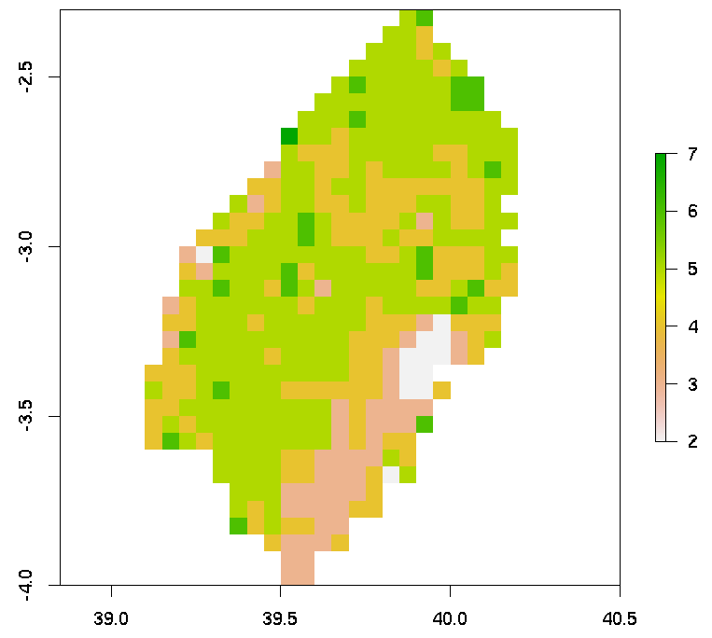
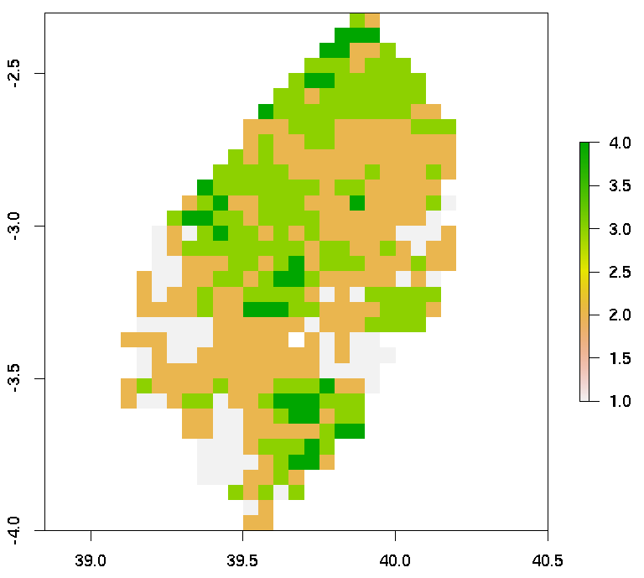
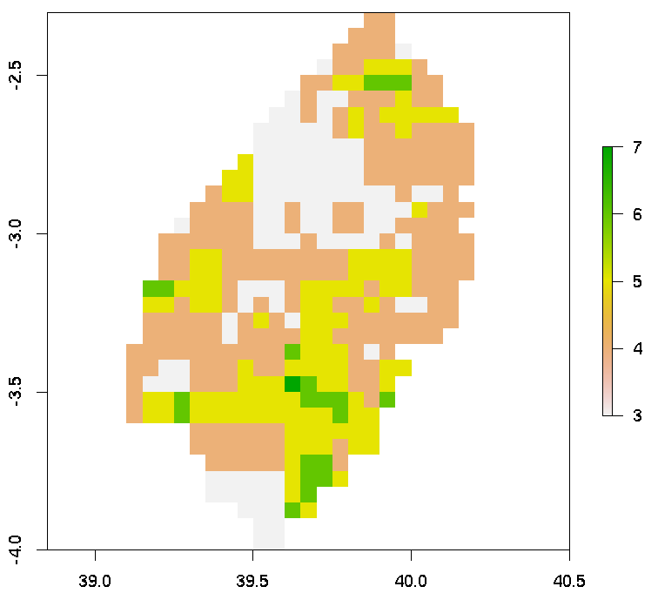
1981
2001
Kilifi
1991

Slide 3
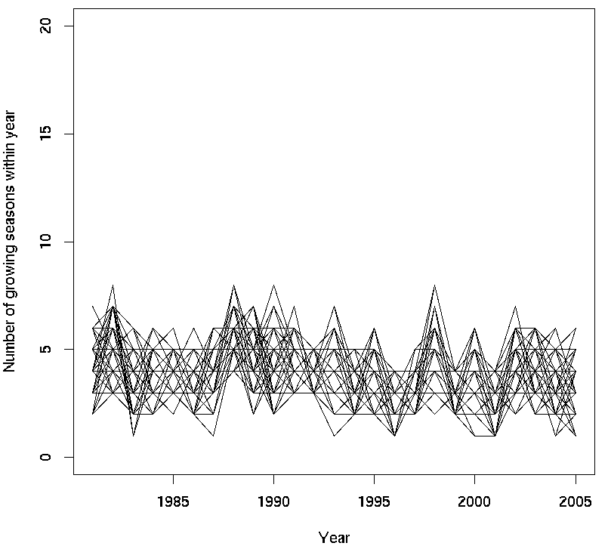
Kilifi county for historical info
Max: 8
Min: 1

Slide 4
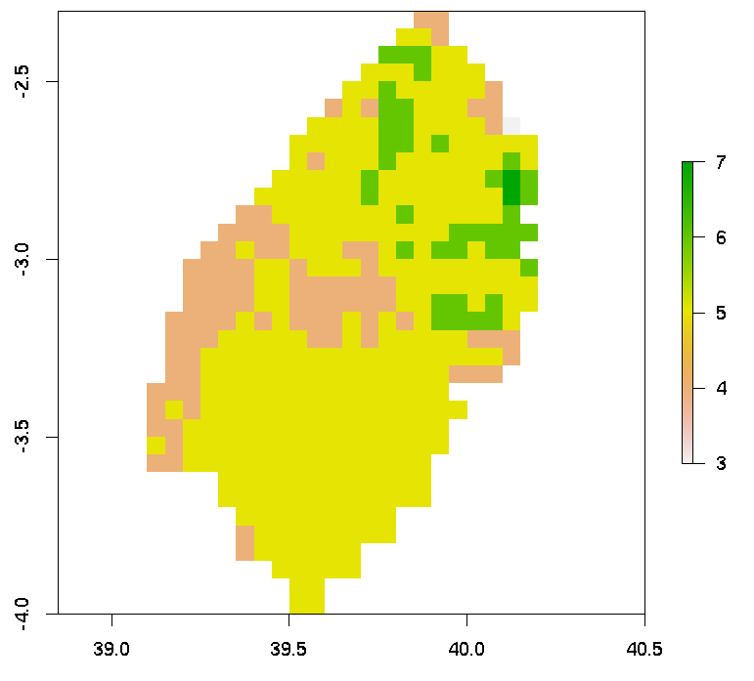
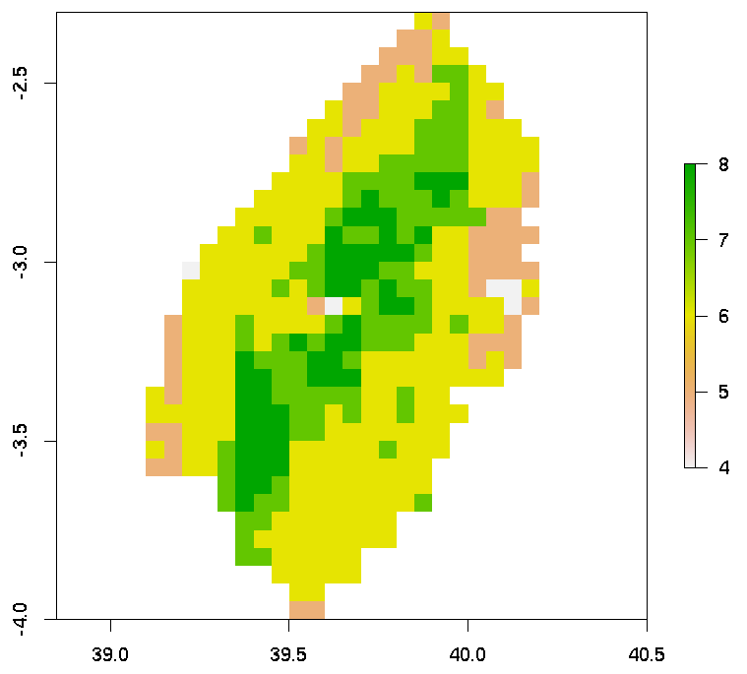
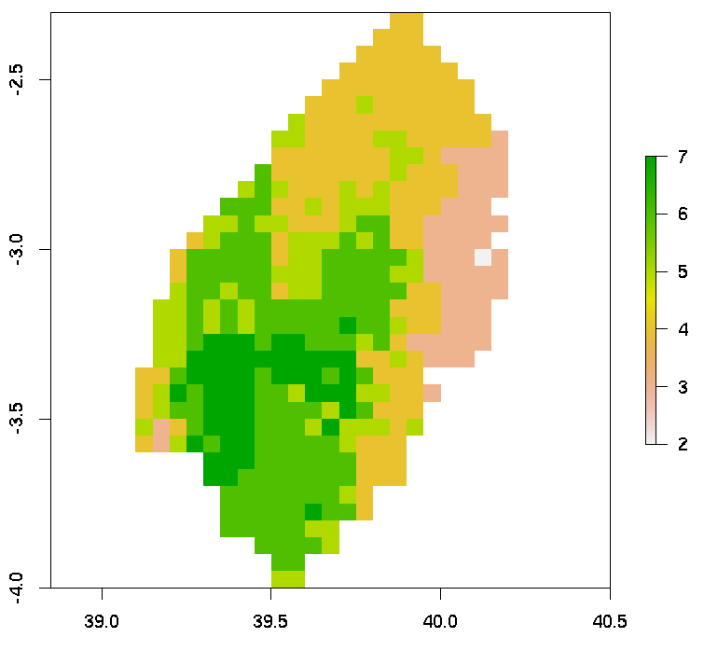
2021
2041
Kilifi
2031

Slide 5
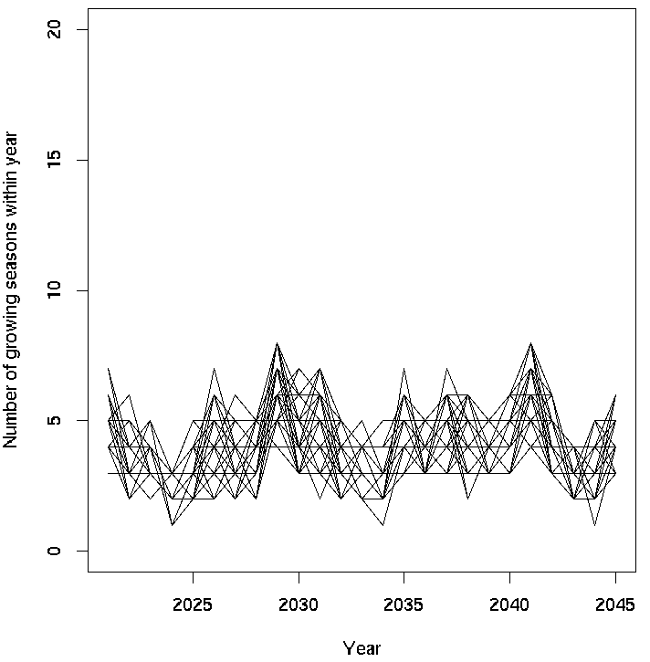
Kilifi county for future info
Max: 8
Min: 1

Slide 6
Current
Future

